Slide 1



Machine Learning
Day 2 - Basics of Neural Networks

Slide 2

Agenda
Neurons and basics of Neural Network
Activations Functions
Deep dive into Tensors
Tensor functions
Layers of Neural Network
What you’ll know.

Slide 3

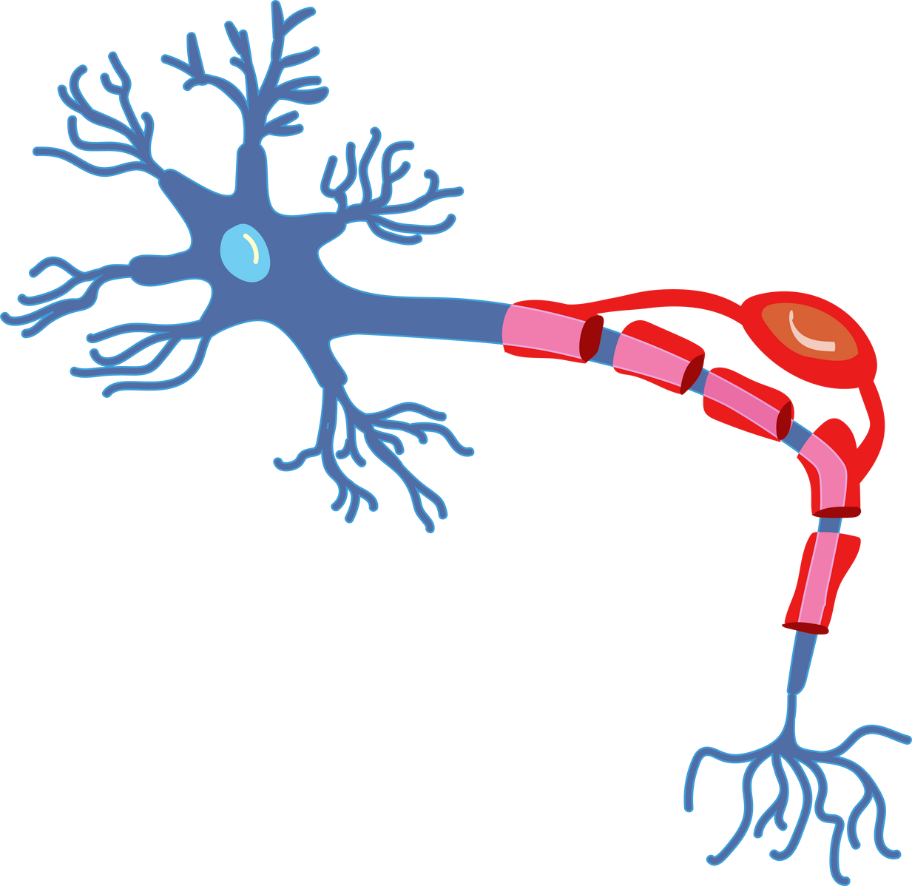
What is a Neuron?
Information messengers in the body.
Uses electrical impulses and chemical signals to transmit information between different areas of the nervous system.

Slide 4

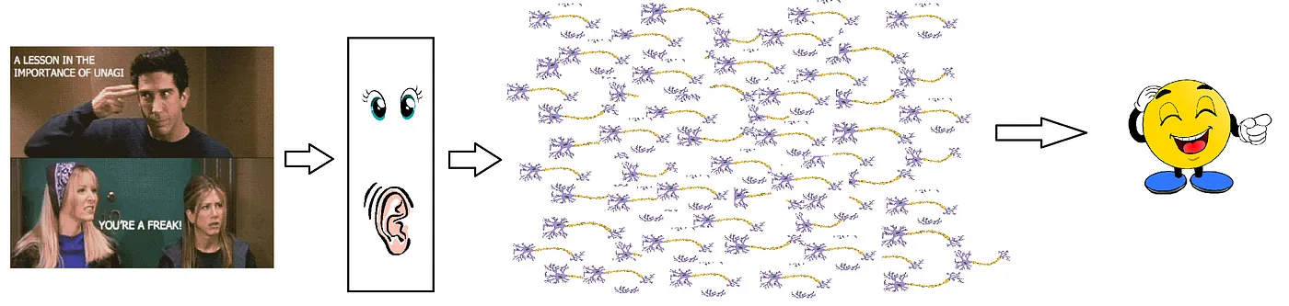
very simplified version of neurons in our brain
massive parallel interconnected network of 10¹¹ neurons (100 billion) in our brain

Slide 5

Perceptron
Perceptron (McCulloch-Pitts neuron) was the first neural network learning model
Simplest form of neural network
Consists of one layer of interconnected nodes, where each connection has a weight associated with it
Specifically, it works as a binary classifier

Slide 6
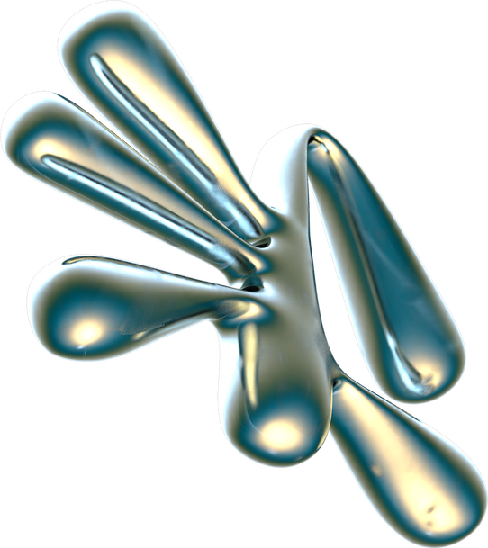
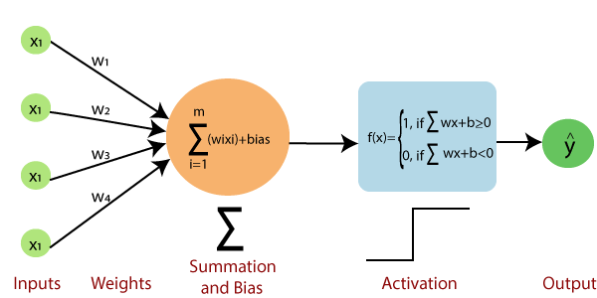
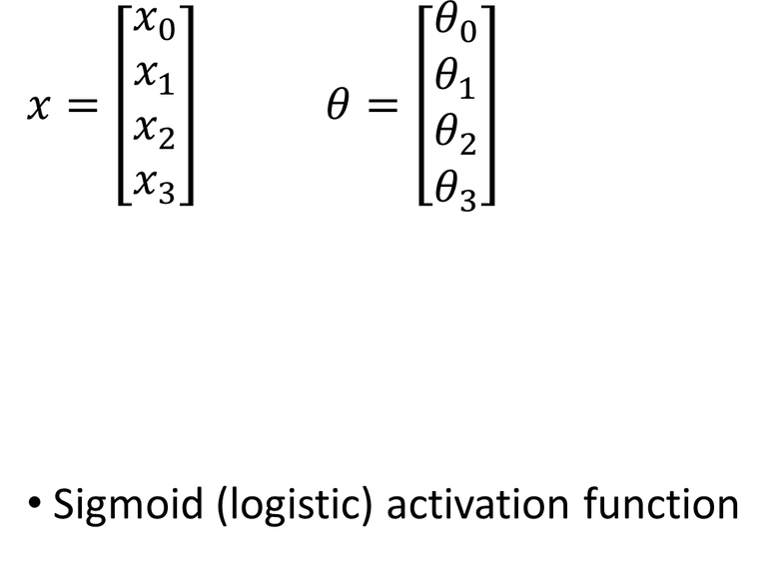
How Perceptron Works?

Slide 7
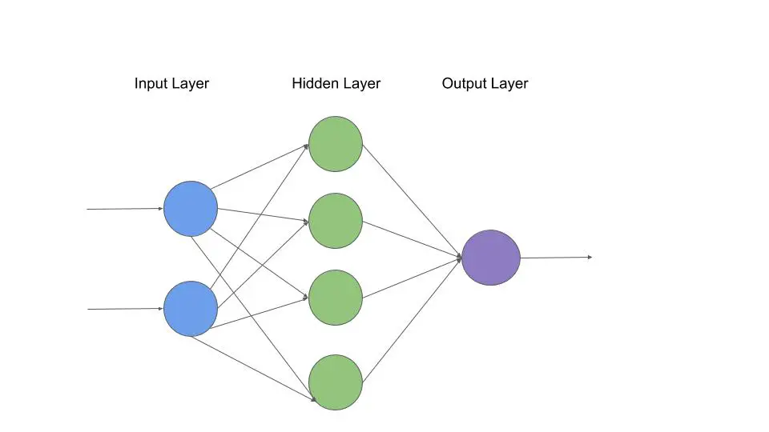
Types of Neural Networks
Single-layer perceptron
Multi-layer perceptron
Input layer
No. of neurons – no. of input features
Hidden layer
More – deep learning network
Output layer
No. of neurons - no. of classes in the problem
1 for binary classification

Slide 8

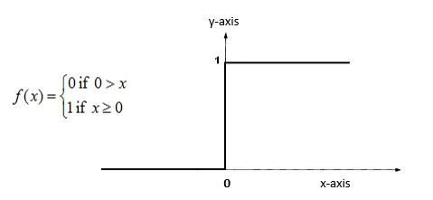
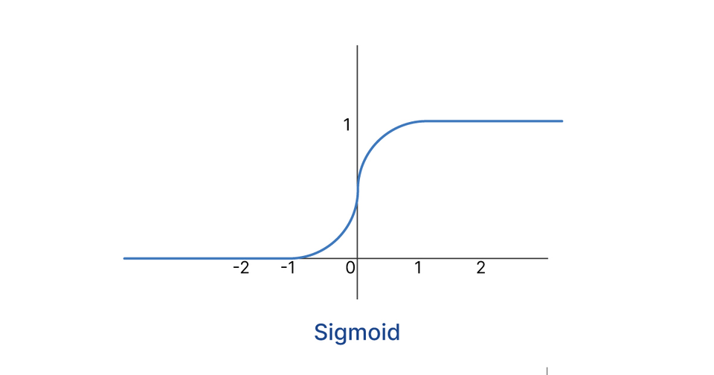
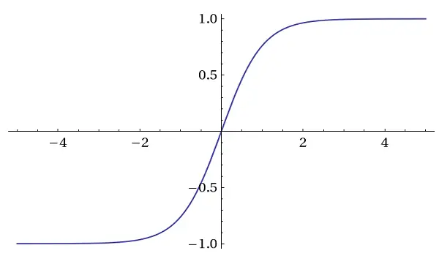
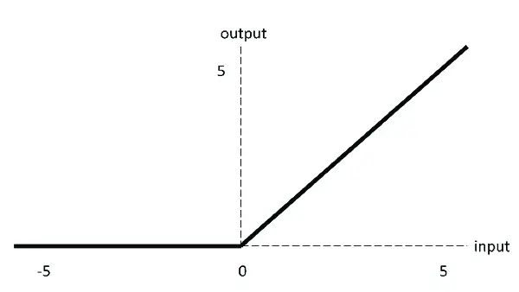
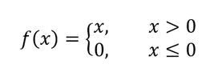
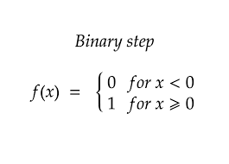
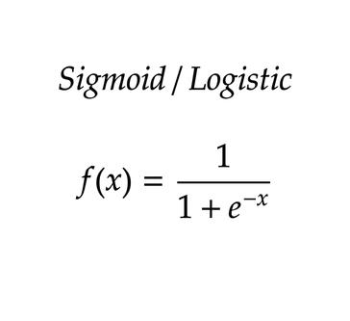
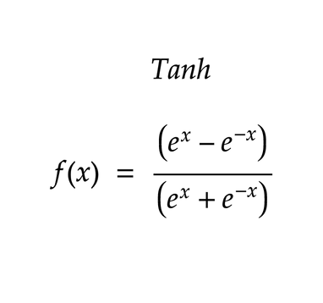
Activation Functions
Think of activation functions in a neural network like a "decision maker" for each neuron. They determine whether a neuron should "fire" and pass its signal to the next layer or not.
Step |  | Sigmoid |  | Tanh |  | ReLU

Slide 9
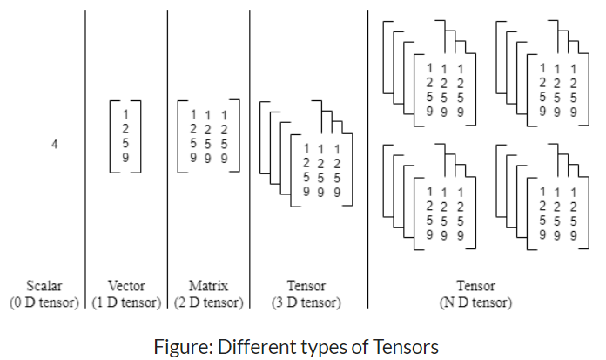
What are Tensors?
Tensors are a generalized way for storing data.
Just a container for data, typically numerical data. It is, therefore, a container for numbers.

Slide 10

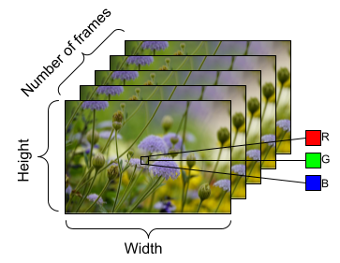
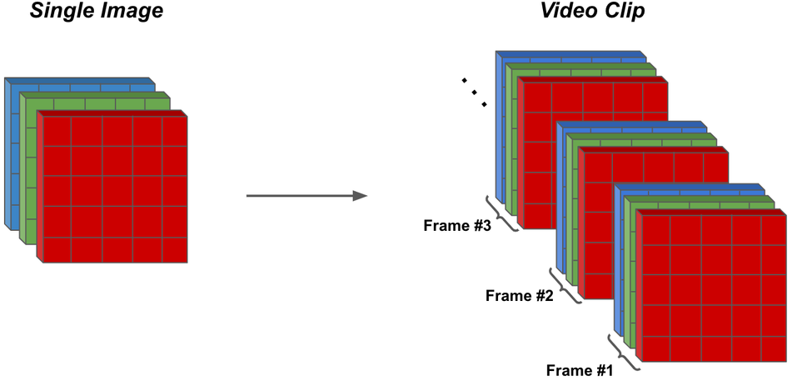
Storing different data
Image (4D tensors)
Videos (5D tensors)

Slide 11
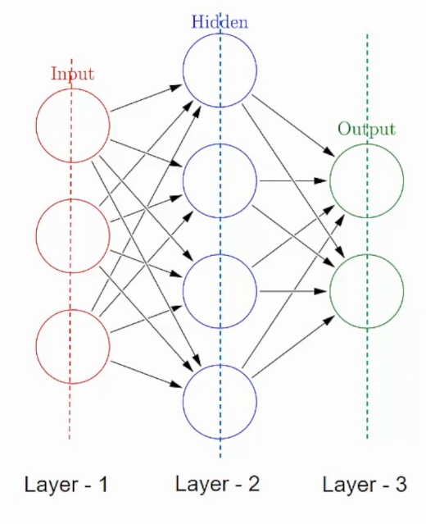
What are Layers?
A neural network is made up of stacked components called Layers.
Input Layer - accepts the data and pass it to the rest of the network.
Hidden Layer - either one or more in number for a neural network. Performs multiple functions at the same time such as data transformation, automatic feature creation, etc.
Output Layer - holds the result or the output of the problem.

Slide 12
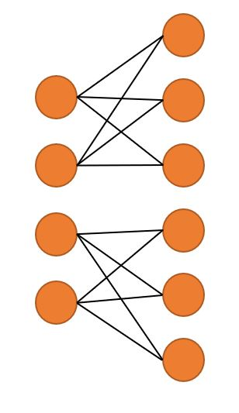
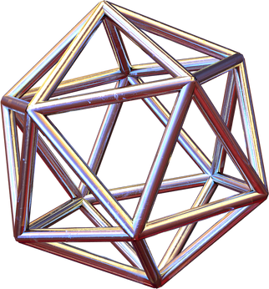
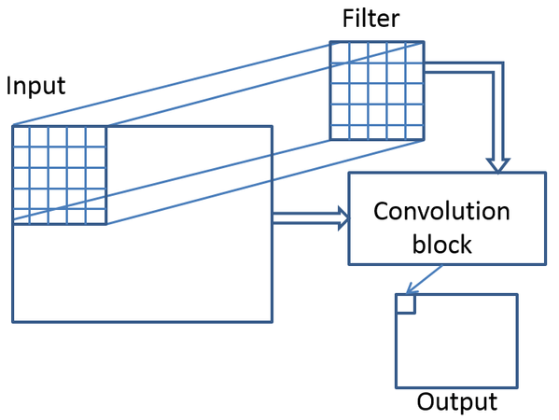
Layers in torch.nn
Linear Layer (torch.nn.Linear):
Also known as a fully connected layer.
Applies a linear transformation to the input data.
Used for tasks like classification or regression.
Convolutional Layer (torch.nn.Conv2d):
Specifically designed for processing grid-structured data like images.
Apply a series of filters to the input data to extract features.

Slide 13
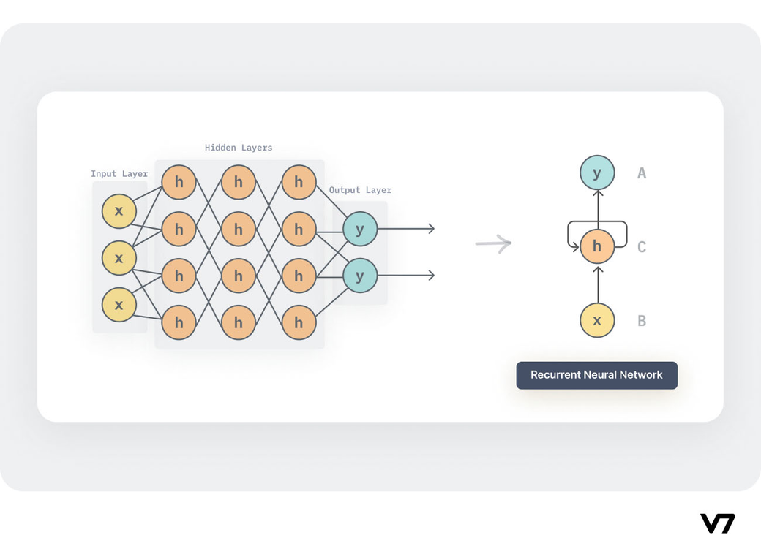
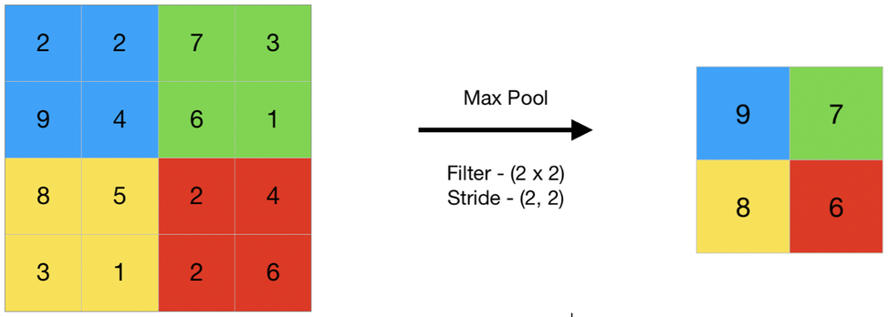
Layers in torch.nn
Recurrent Layer (torch.nn.RNN, torch.nn.LSTM, torch.nn.GRU):
Used for processing sequential data, where the order of the elements matters.
Maintains a hidden state that is passed through time steps, allowing the network to capture temporal dependencies.
Pooling Layer (torch.nn.MaxPool2d, torch.nn.AvgPool2d):
Downsample the spatial dimensions of the data
Reduces computation and helps in focusing on more significant features.

Slide 14
Thank you :)
We hope you learned something new.

